Slide 1
Final Presentation: Showcase and Reflection
Xinyuan (Nick) Li, MA student in Liberal Studies
Videogame Design and Critique | CMAC 755S

Slide 2
Today’s Key Points
Pre-Production Work:
World Building
Character Write Ups
Sketches
Models
Etc.
Tutorial Game Level Showcase:
A detailed walkthrough of the completed tutorial game level
The player experience and how it aligns with the design goals.
Design Decisions Explanation:
The rationale behind key design decisions made during the development of the tutorial level
Challenges faced and how they were addressed.
Course Wrap-Up and Thoughts:
Overall experience in the course
Thoughts and aspirations for future endeavors in game design or related fields.

Slide 3
Initial concept and World Building
Initial concepts:
City
Political polarization
The Rise of Asians in Entertainment
Retro (everyone loves it)
The world is in the capital and first metropolis of a fictional country.
It's an election year, and in this multi-party country.
The player is part of a girl idol group where your colleagues come from different family or political backgrounds.
The game's soundtrack features Japanese 80s techno music.

Slide 4
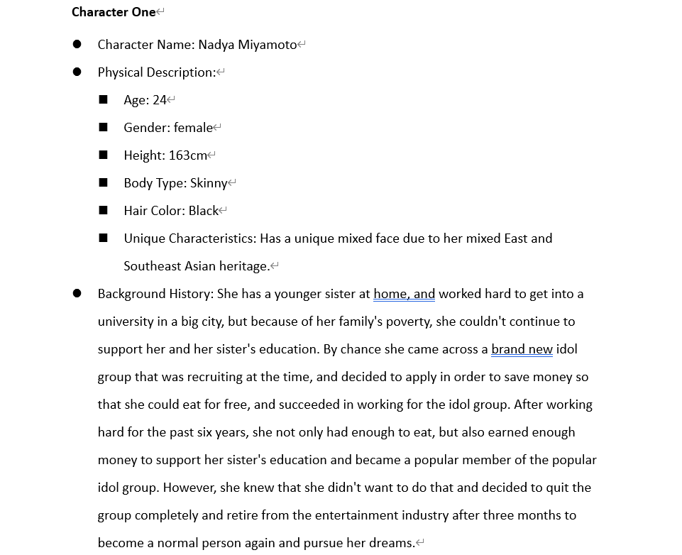
Character Write Ups
NPCs are critical in this RPG, so the characters are meticulously designed for their content.

Slide 5
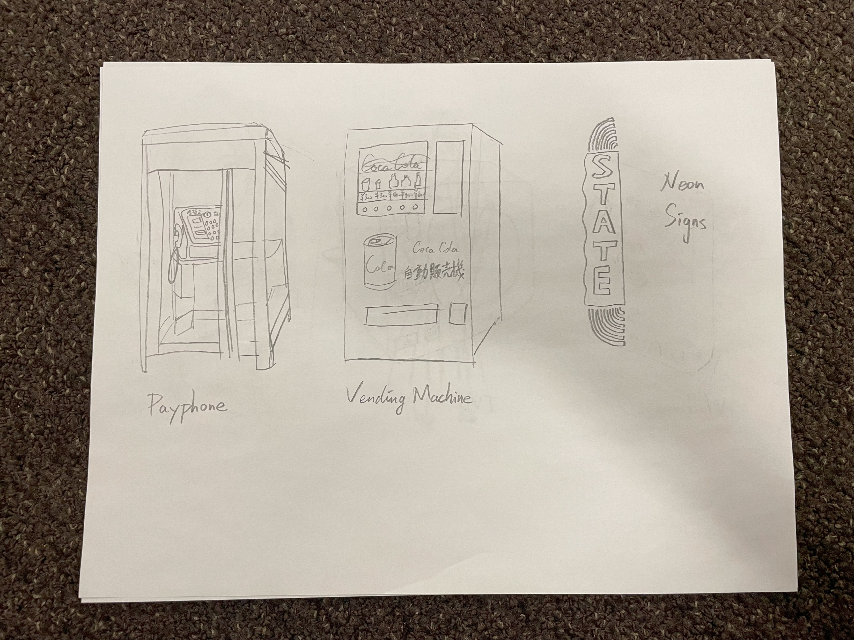
Sketches & Models
Sketches & Models are trying to be as nostalgic and Asian as possible.

Slide 6
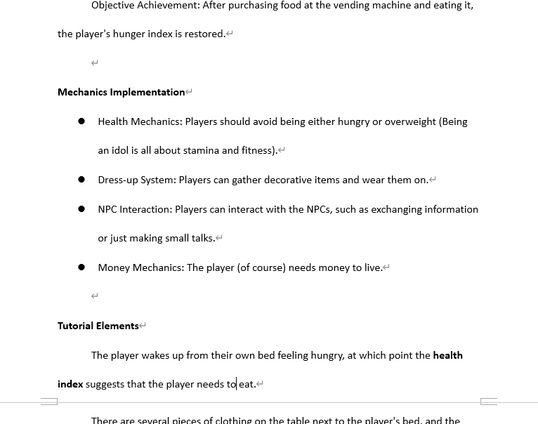
Level design document
Due to time constraints, the Dress-up System could not be realized.

Slide 7
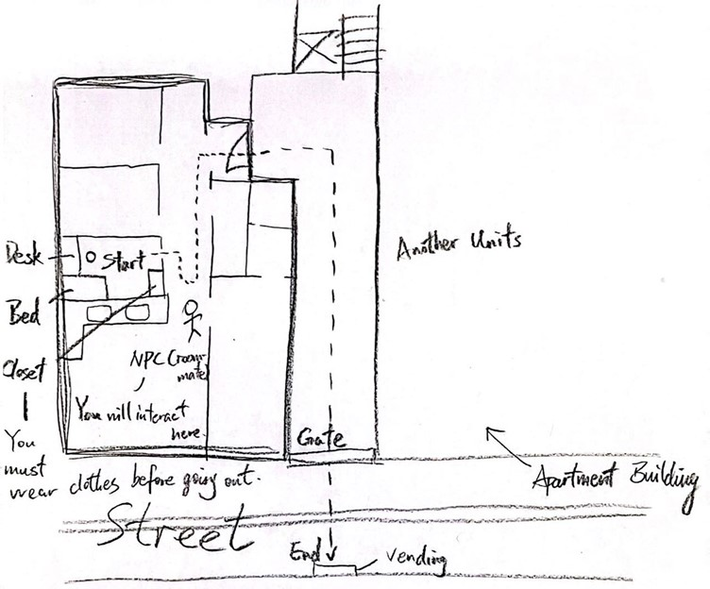
Level layout
The layout plan presents the apartment located on the first floor and the walkway and outdoor street.

Slide 8
Playthrough
(See the other video)

Slide 9
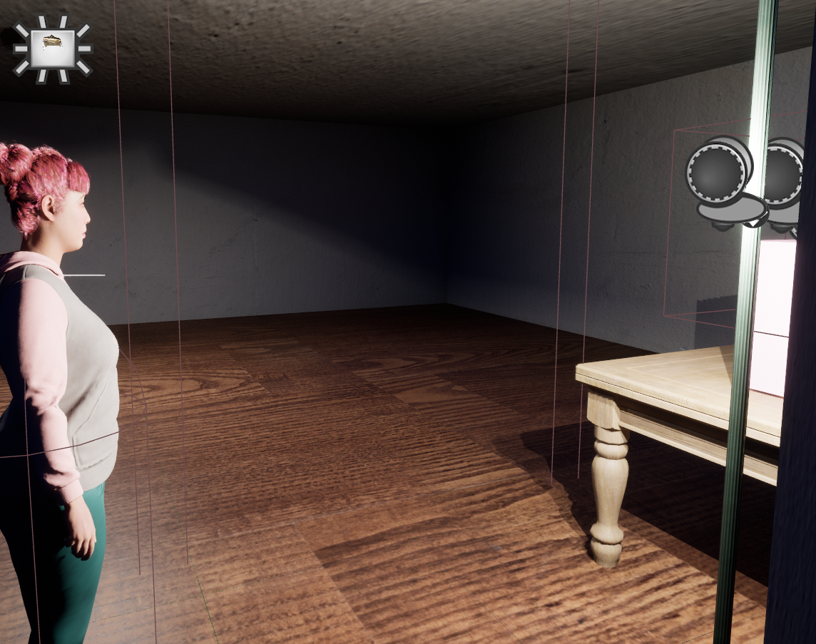
Choice of mechanics and interactions
Hunger mechanic
Currency mechanic
NPC interaction mechanic with the help of plugins.

Slide 10
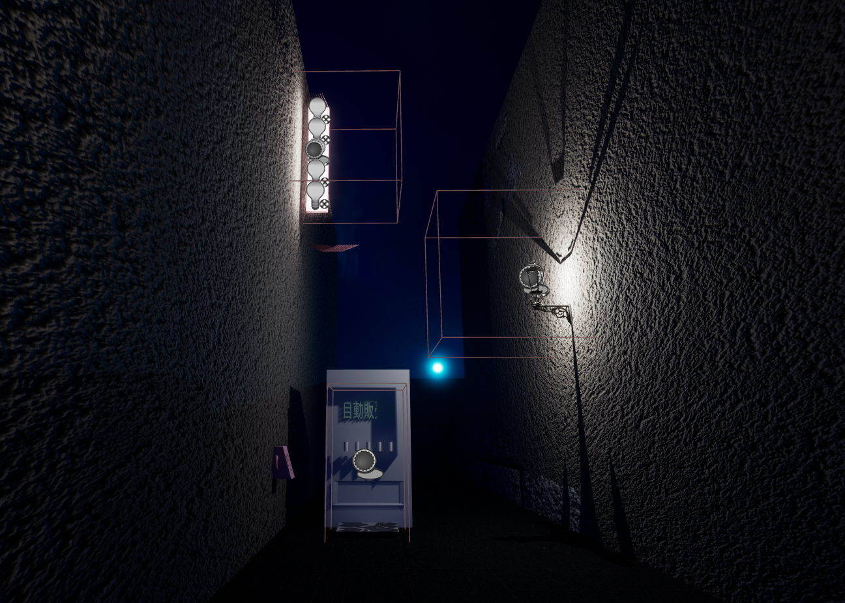
Art style and aesthetic direction
Narrow alleys, neon lights, vending machines, these are all elements that make up this neighborhood of this virtual city.

Slide 11
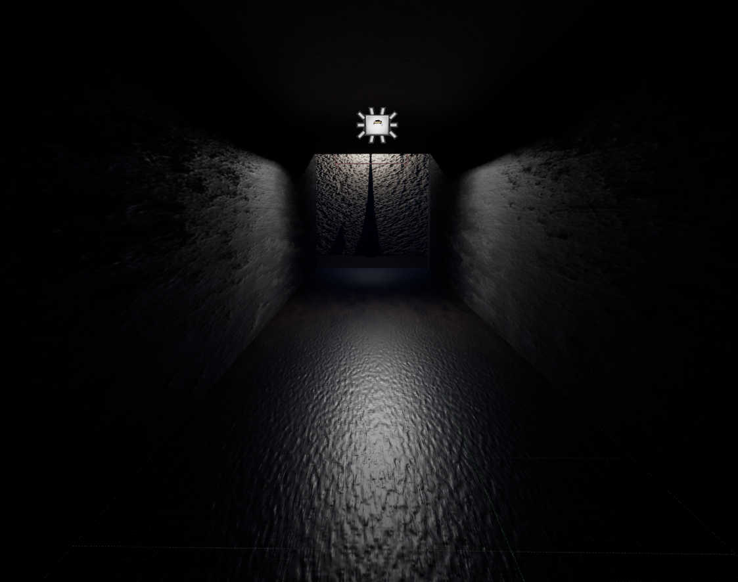
Lighting and sound design choices
Placing a street light (spot light) or a long lamp (rectangular light) at or near the exit will guide the player.
Sound effects are not available yet, partly because they are relatively minor for my theme.

Slide 12
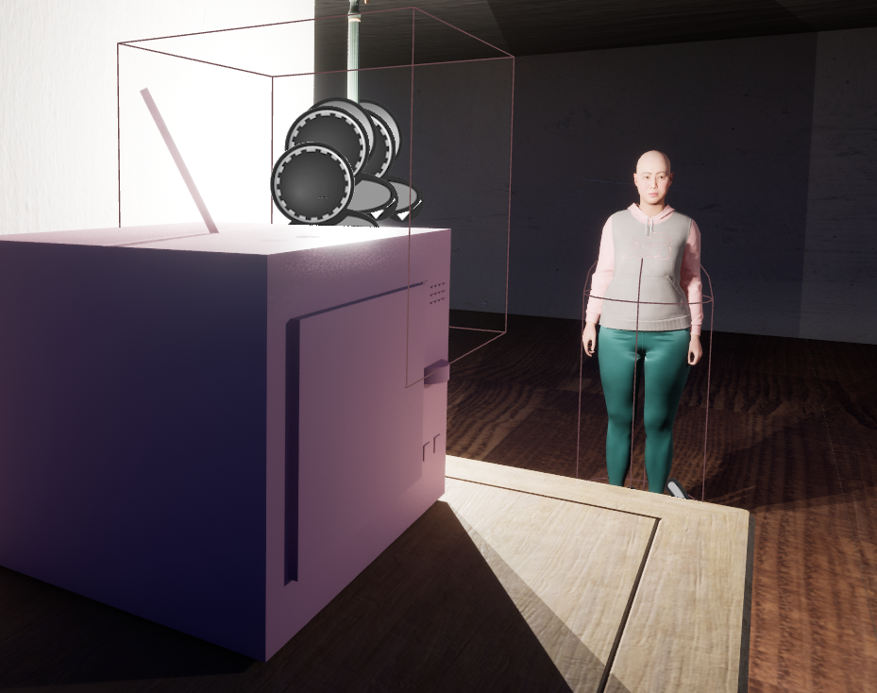
Challenges
Performance optimization
Lack of materials

Slide 13
Reflection
Most Enjoyable and Valuable Aspects
Areas of growth or improvement
Lessons and skills
Future Aspirations

Slide 14
Credits and Acknowledgments
This project uses the following from the Marketplace:
ConvAI,
Edith Finch,
Free Furniture Pack,
Necro's Utility Material Pack,
Quixel Bridge contents,
Scanned 3D People Pack.
The soundtrack used was “1000 Knives" by YMO.
Acknowledgement to Hilary N. Huskey, Instructor of the Videogame Design and Critique course, and all of my classmates. I was able to complete this project thanks to their guidance or advice.

